Slide 1
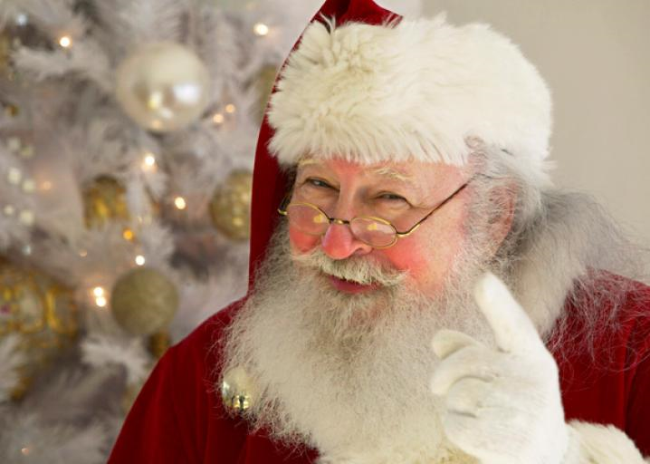
Virginia’s Convolutional Neural Network Using Python And Keras

Slide 2
Purpose - Yes Virginia, There Is A Santa Claus!!
Is it Santa Claus??
Machine Learning image assessment model (Convolutional Neural Network w/ LeNet architecture)
Trained to determine, with a percent confidence, if an image is Santa Claus or not
Website front-end with capability of taking image input and returning prediction

Slide 3
Convolutional Neural Networks
A class of deep neural networks, applied to analyzing visual imagery
Uses little pre-processing compared to other image classification algorithms.
Independently learns the filters of traditional hand-engineered algorithms.
Independence of prior knowledge / human effort is a major advantage.

Slide 4
LeNet Architecture
One of the first convolutional neural networks (CNN’s)
A “Supervised Learning” model
Helped propel the field of “Deep Learning”
Originally used for character recognition

Slide 5
Applications - Convolutional Neural Networks
Image and video recognition
Recommender systems
Image classification
Medical image analysis
Natural language processing.

Slide 6
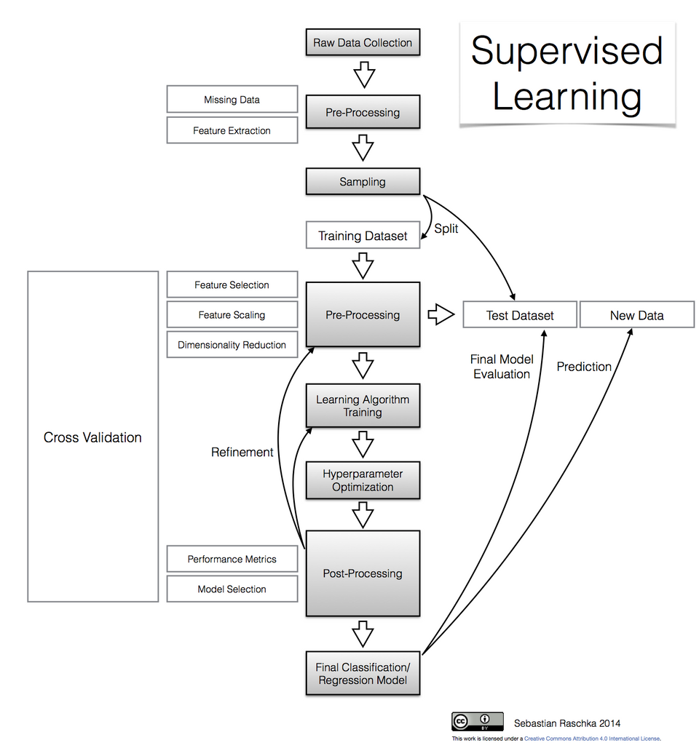
CNN Learning process

Slide 7
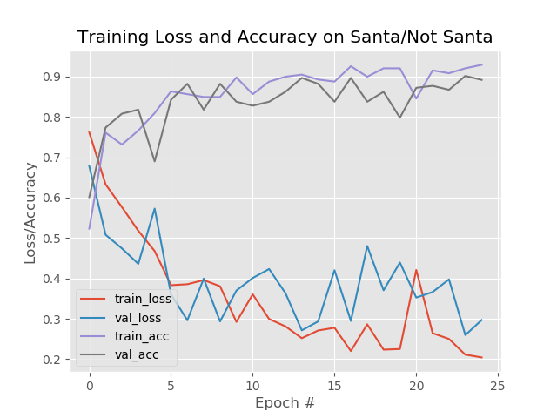
SantaVision - Training and Testing Results

Slide 8
Image Data Sets
Image Gathering – Three Sets:
Downloaded from Google image searches in batches
Initial Scrubbing to remove faulty / duplicate images
Initial net images:
Santa – pictures and illustrations (~550)
White Beards – various men with white beards (~300)
Random – miscellaneous images –no Santa’s or White Beards (~1000)

Slide 9
Image Data Sets
Munging
Reviewed all images for clarity and appropriateness
Reduced initial data set by approximately ~900 images
Final set contained ~825 images to be analyzed
Not all image types processed w/ CNN program (i.e. GIF files)
JPEG image type worked most consistently

Slide 10
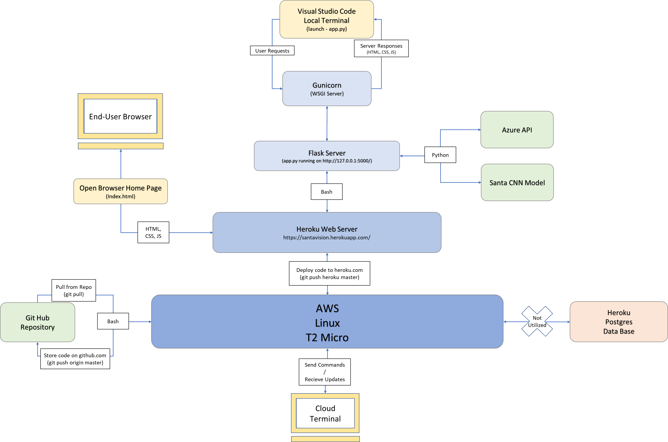
CNN System Architecture

Slide 11
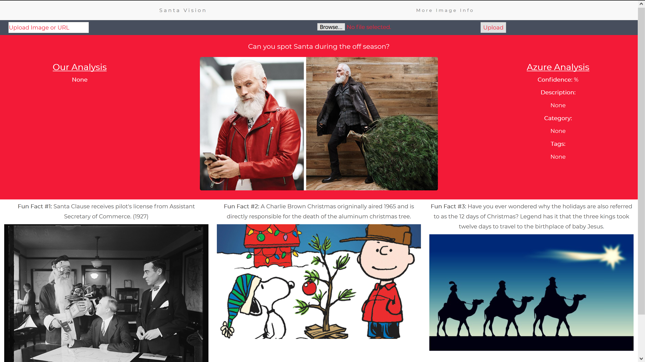
https://santavision.herokuapp.com/

Slide 12
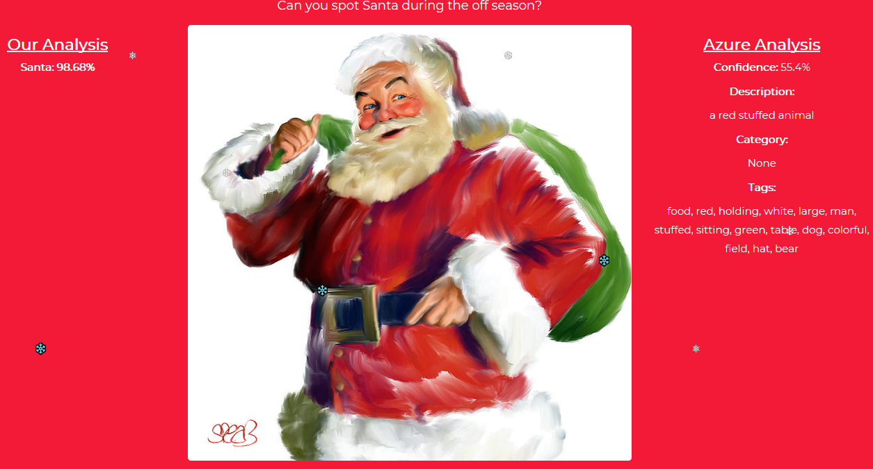
Good Predictive Results… Right?

Slide 13
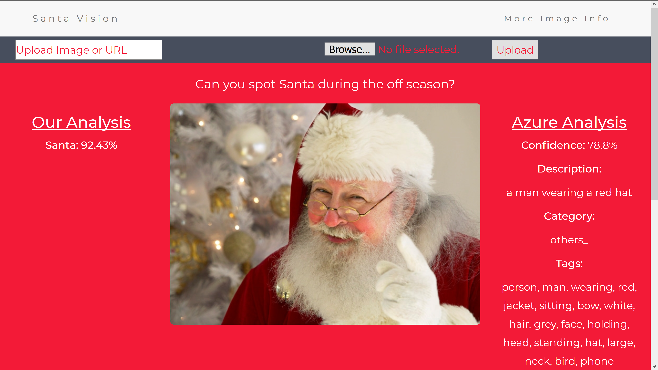
Is This The REAL Santa??…

Slide 14
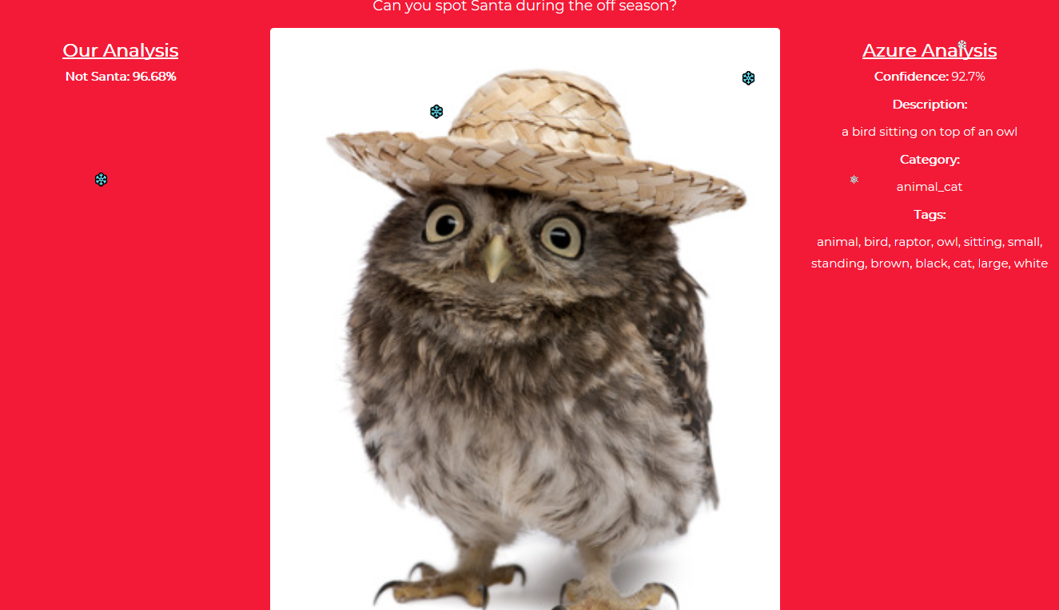
Good Predictive Results… Definitely NOT Santa

Slide 15
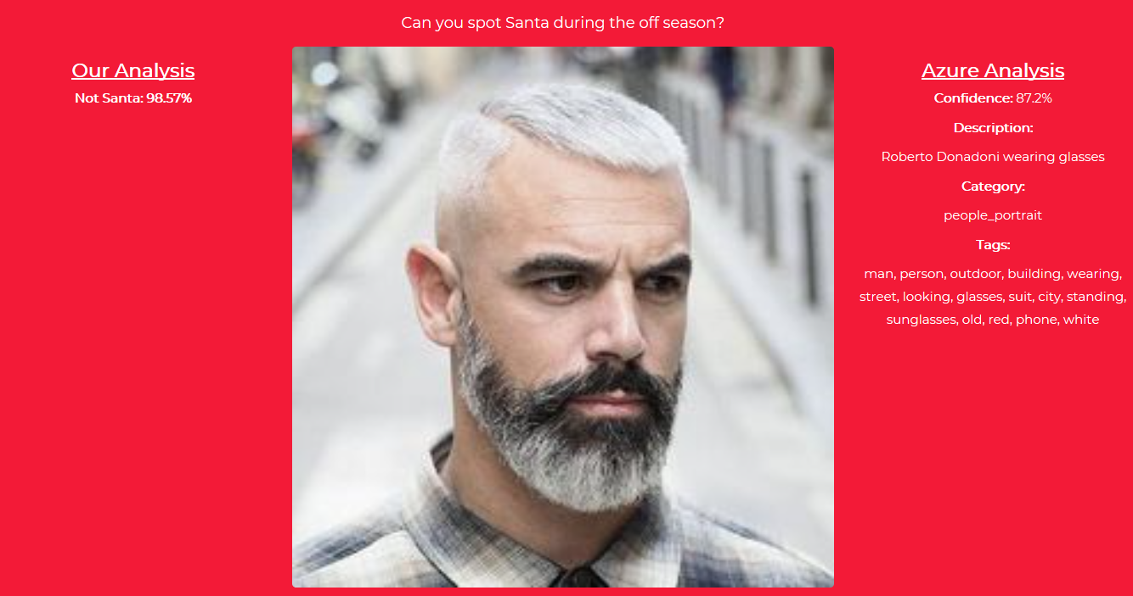
Good Predictive Results… Santa’s Nephew?

Slide 16
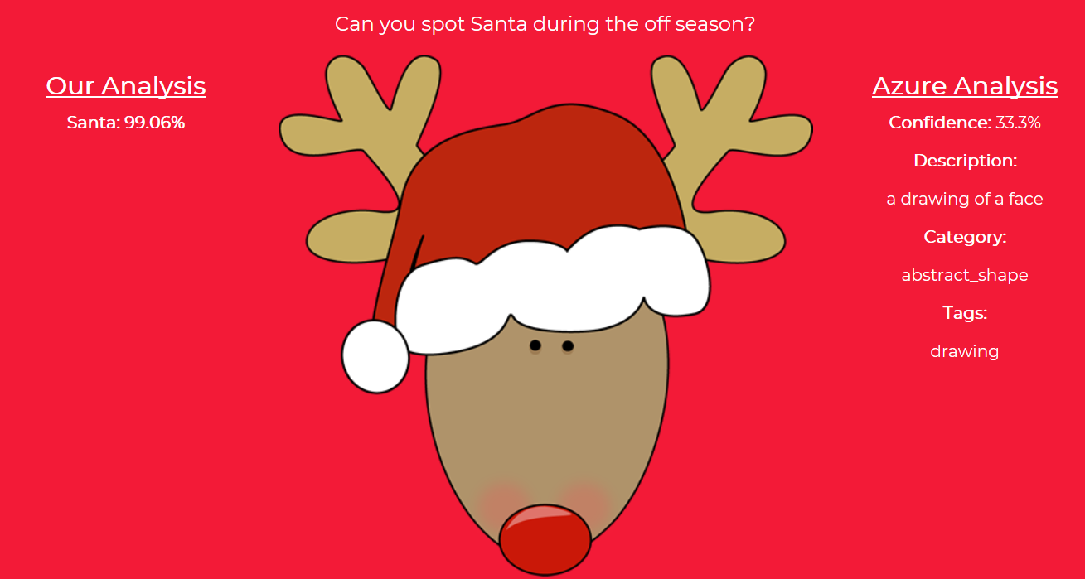
Good Predictive Results?… Not Exactly…

Slide 17
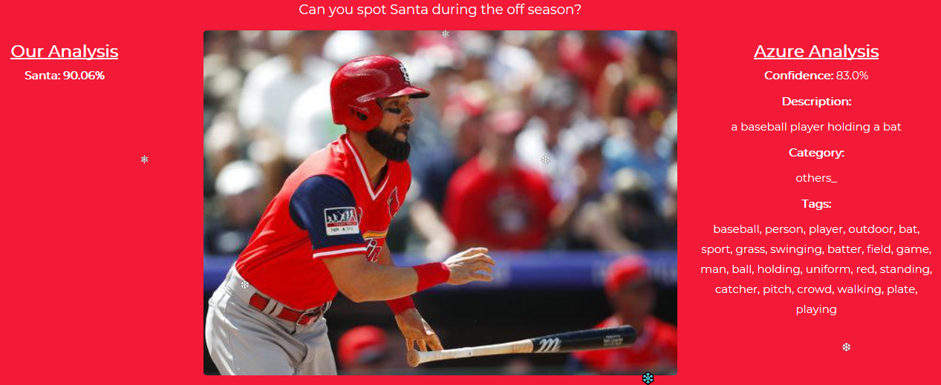
Definitely… Not Exactly…

Slide 18
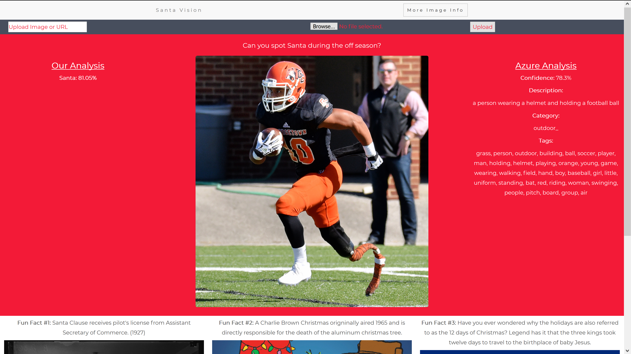
Hmmm… Perhaps, He’s Given Christmas Gifts…

Slide 19
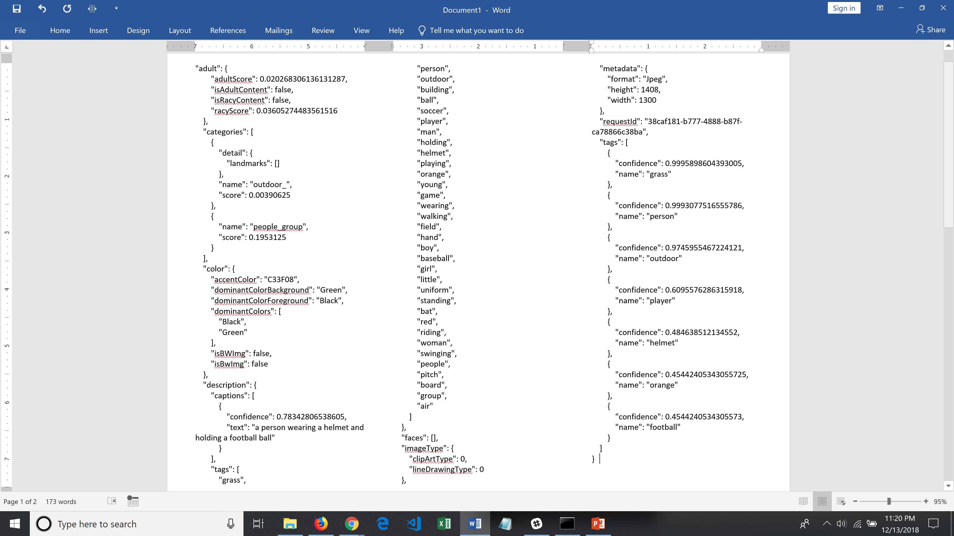
Azure Analysis – Football Player

Slide 20
Future Uses of Virginia’s CNN
Construct “SMART” family photo album
Hundreds of family images from various family members
Train on subsets for different characteristics / classes
Develop web based album for extended family member search / download

